Slide 1
Supplier FAI Instructions

Slide 2
Purpose
To provide guidelines and helpful tips to our suppliers to enable them to submit complete and compliant First Article Inspection Reports, as well as to outline any ABT specific requirements above and beyond AS9102 (current revision).
Portions of the following information are taken directly from the AS9102C specification, which is the governing document for FAI reports. To procure a copy of the entire specification, go to https://www.sae.org/standards/content/as9102/. This standard document is not available to the public and will not be provided by ABT.

Slide 3
Getting To Know The Forms
The AS9102 First Article Inspection Report is comprised of three forms. Use all three forms to document the results of the First Article Inspection. Additional sheets can be used as needed. Please use current AS9102 revision when submitting the First Article Inspection.
AS9102 Form 1: Part Number Accountability shall be used to identify the part that is being inspected (FAI part) and associated sub-assemblies or detail parts.
AS9102 Form 2: Product Accountability – Raw Material, Specifications and Special Process, Functional Testing shall be used if any material, special processes or functional testing are defined as a design requirement.
AS9102 Form 3: Characteristic Accountability, Verification and Compatibility Evaluation shall be used to record an actual measurement or inspection/verification of the FAI part for every design characteristic on the drawing, including the drawing notes.

Slide 4
Getting To Know The Forms
The input fields on the forms fall into the following categories:
Required: meaning this is mandatory information. These fields are highlighted yellow.
Conditionally Required: meaning this field must be completed when applicable. These fields are highlighted blue.
Optional: meaning information is required when available or as specified by design. These fields are not highlighted.

Slide 5
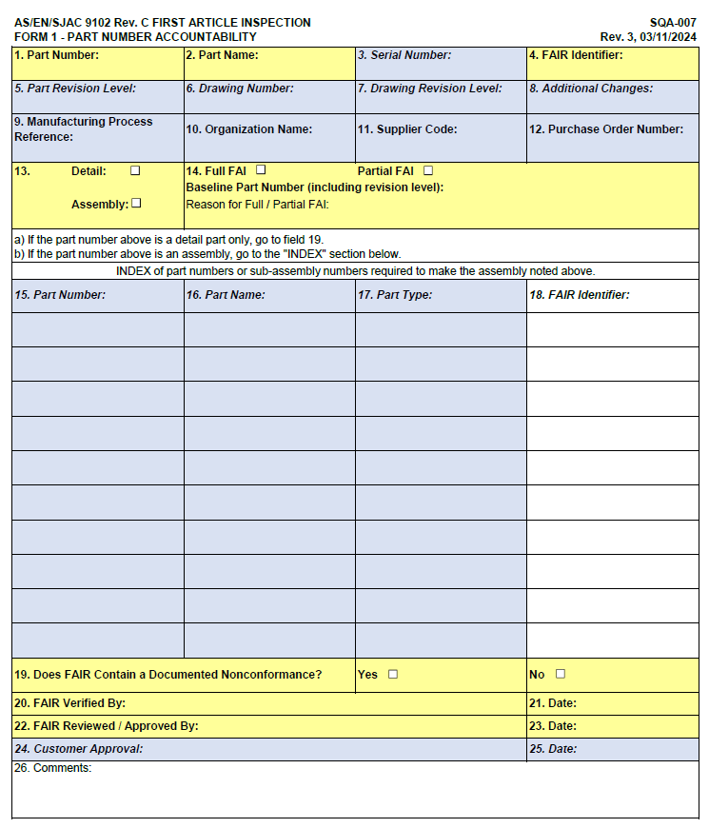
Form 1

Slide 6
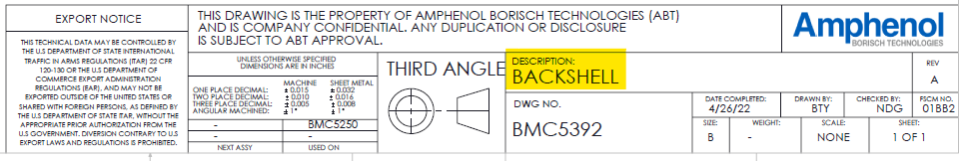
Form 1
1. (R) Part Number: Number of the FAI part
2. (R) Part Name: Name of the FAI part – found in the Title Block of the
blueprint (drawing).
3. (CR) Serial Number: Serial number of the FAI part; unique identifier
assigned to a detail part, sub-assembly, or by the organization of customer.
4. (R) FAIR Identifier: Identifier of the First Article Inspection Report.
5. (CR) Part Revision Level: Latest revision that affects the FAI part being inspected. If the part has not been revised, indicate as such (ex. N/C, No Change, or -).
continued next page…

Slide 7
Form 1
6. (CR) Drawing Number: Drawing number associated with the FAI part.
7. (CR) Drawing Revision Level: The revision level of the drawing associated with the FAI part. NOTE – the drawing number can be different from the part number.
8. (CR) Additional Changes: Reference numbers of any changes that are incorporated in the product, but not referenced on the drawing (ex. Engineering changes, manufacturing changes, or deviations).
9. (R) Manufacturing Process Reference: ABT uses our internal traveler number as the process reference.
10. (R) Organization Name
continued next page…

Slide 8
Form 1
11. (O) Supplier Code: The unique vendor / supplier code assigned by ABT. If one is not assigned via the PO, then use your Cage Code number.
12. (O) P.O. Number: Customer purchase order, if applicable.
13. (R) Type of FAI; check as appropriate
14. (R) Full FAI / Partial FAI: Check, as appropriate.
For at partial FAI, provide the previous part number, including revision level. For partial FAIs based on similar parts, provide the approved configuration or FAI part number, including revision level.
Baseline Part Number (including revision level): For a partial FAI, provide the previous FAI part number or approved configuration (including revision level).
Reason for Full/Partial FAI: Describe the reason for full or partial FAI.
continued next page…

Slide 9
Form 1
Data Fields 15, 16, 17, and 18: This section is required only if the part number identified in field 1 is an assembly. All BOM parts (e.g., detail parts, sub-assemblies, COTS) that are part of the assembly, identified in field 1, shall be listed in this section.
15. (CR) Part Number: Part number included in the assembly and items from the Bill of Materials (BOM) or the Customer Part List.
16. (CR) Part Name: Name of the part installed on the assembly.
17. (CR) Part Type: (If applicable).
18. (CR) FAIR Identifier: Report number for the detail parts and associated assemblies.
19. (R) Does FAIR Contain a Documented Nonconformance(s)?: When a nonconformance(s) has been documented in the FAI, check “Yes.”
continued next page…

Slide 10
Form 1
20. (R) FAIR Verified By: Legible identification of the person verifying the evaluation activities were completed.
21. (R) Date when field 20 was populated.
22. (R) FAIR Reviewed / Approved By: Legible identification of the person from the organization who reviewed and approved the FAI. Should NOT be the same individual identified in field 20.
23. (R) Date when field 22 was populated.
24. (CR) Customer approval: used by customer to record approval.
25. (CR) Date when field 24 was populated.
Note: In fields 20, 22, and 24, electric identification is acceptable.

Slide 11
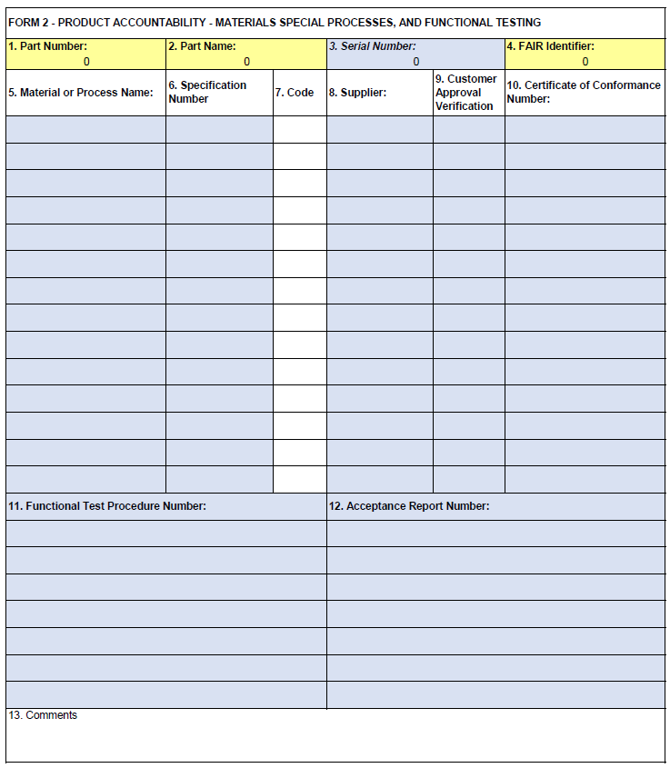
Form 2

Slide 12
Form 2
NOTE: Data fields 1 thru 4 are repeated on all forms for convenience and traceability but should be validated.
5. (CR) Material or Process Name: Name of applicable materials or special processes.
6. (CR) Specification Number: Provide the following information:
* Material specifications and material form (e.g., sheet, bar, plate) for all materials incorporated into the FAI part (e.g., weld or solder).
* Special process specifications; including class, type, revision, as applicable.
* If standard catalogue items or COTS are modified, then list that standard hardware or COTS item. NOTE: Non-modified standard catalogue items are listed on Form 1, “Part Number Accountability.”
7. (O) Code: Any required code from the customer for material or process listing, or expiration date.
continued next page…

Slide 13
Form 2
8. (CR) Supplier: List supplier name, address, and code if performing special process or supplying material.
9. (CR) Customer Approval Verification: Indicate if the special process(es) or material sources are approved by the customer. Use the drop-down menu to choose the appropriate entry.
10. (CR) Certificate of Performance Number: The applicable certification number that can be used for traceability.
11. (CR) Functional Test Procedure Number: Test procedure number identified as a design characteristic.
12. (CR) Acceptance Report Number: The functional test certification indicating that test requirements have been met.
13. (O) Comments: Provide supporting comments, as applicable.

Slide 14
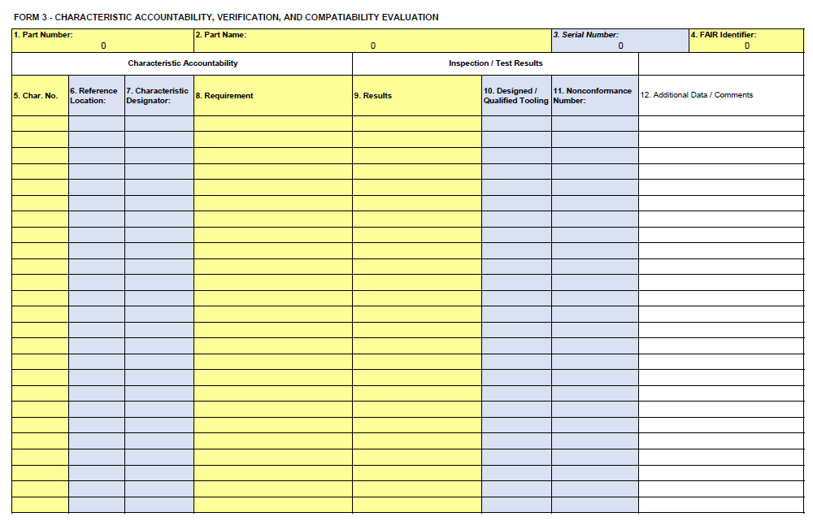
Form 3

Slide 15
Form 3
NOTE: Data fields 1 thru 4 are repeated on all forms for convenience and traceability but should be validated.
5. (R) Char. No.: Unique assigned number for each design characteristic. (See SQA-007 for full instructions.)
6. (CR) Reference Location: Location of the design characteristic. ABT reference locations must include drawing number, sheet number (if over one page), and zone location.
7. (CR) Characteristic Designator: If applicable, record characteristic type (only Critical, Key Characteristic, or Flight Safety). If not applicable, enter “N/A” or leave the field blank.
8. (R) Requirement: Specified requirement for the design characteristic with associated nominal dimension and tolerances, drawing notes, and/or specification requirements.
continued next page…

Slide 16
Form 3
9. (R) Results: List measurement(s) obtained for the design characteristics.
* Results must be listed as “Conforms” if the requirement is an attribute, or a numerical result if the requirement is a variable. (See SQA-007 for full instructions.)
10. (CR) Designed Tooling: When specially designed tooling is used for attribute acceptance of a characteristic, record the tool identification number. When qualified tooling is used, record the gauge value or range (min/max value), as applicable.
11. (CR) Nonconformance Number: If the characteristic is found to be nonconforming, record a nonconformance document reference number.
12. (O) Additional Data / Comments

Slide 17
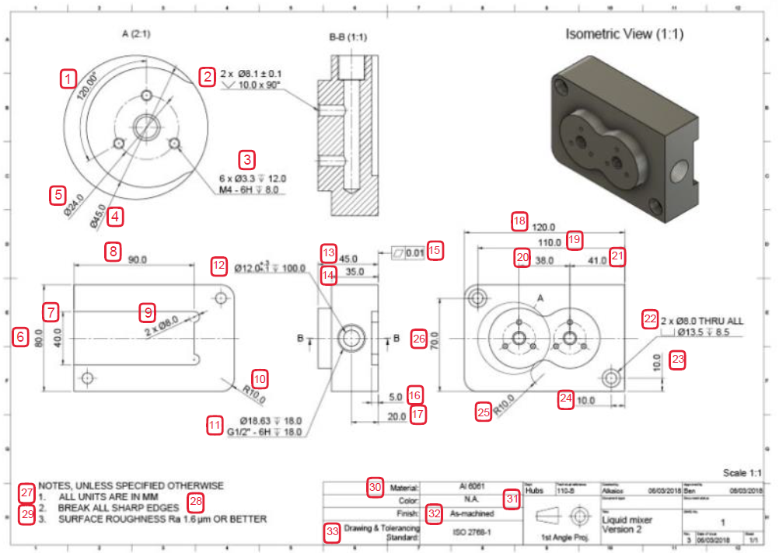
Example of Ballooned Drawing
All notes and characteristics on a drawing must be ballooned

Slide 18
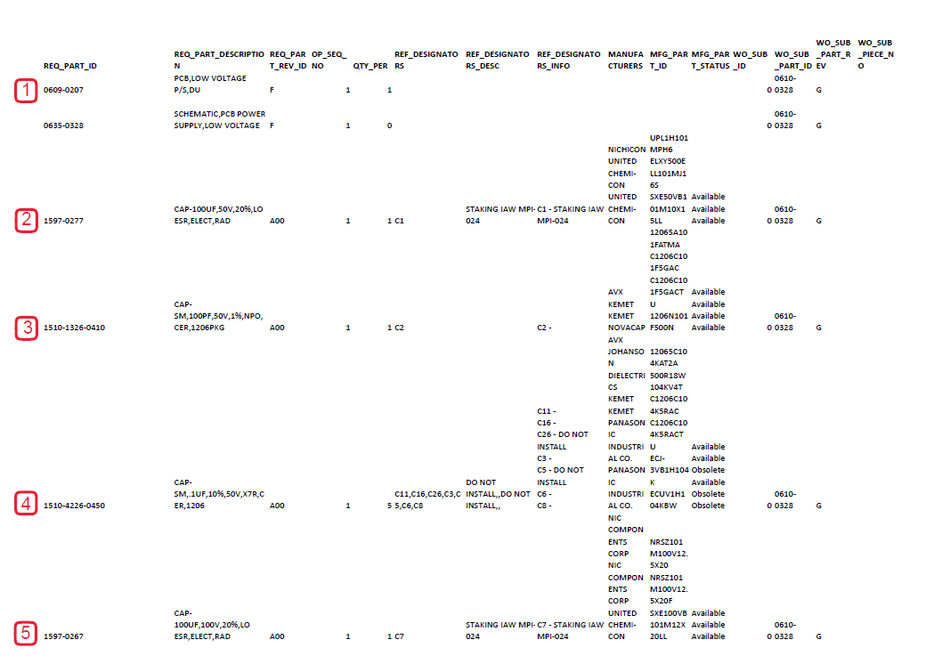
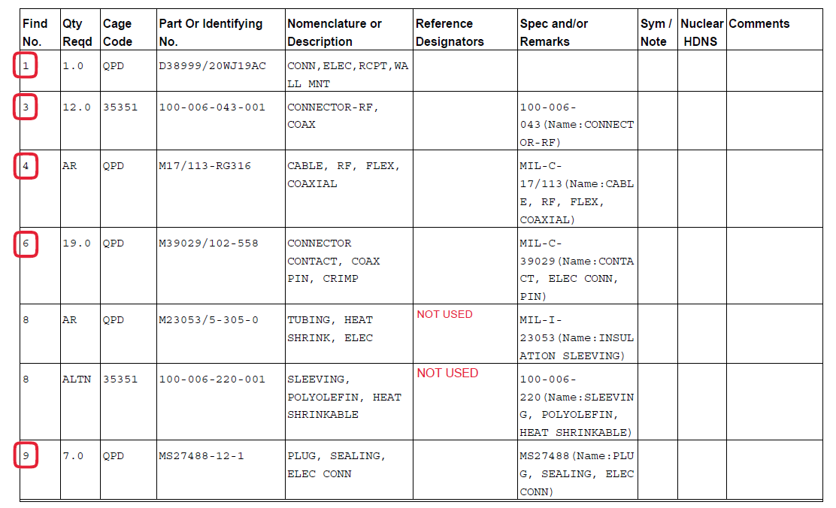
Example of Ballooned Parts List
If there is a separate parts list, that must also be ballooned.

Slide 19
Revision History
Revision | Date | Author | Change
1 | 12/29/22 | E. Merritt | Original Release
2 | 10/31/23 | E. Merritt | Updated forms and instructions to meet new AS9102 revision (Rev. C).

